Slide 1

DriverPass System Analysis
Kelelah Tome
Notes:
[No speaker notes required for this slide.]

Slide 2

System Requirements
Functional Requirements:
The system shall allow customers to schedule driving lessons
The system shall allow users to create and manage accounts.
Nonfunctional Requirements:
The system must load within 2 – 3 seconds
The system must be secure using encrypted connections
Notes:
[In your speaker notes, include an explanation of the different requirements you determined for DriverPass’s system. What are the functional requirements you selected to describe? What are the nonfunctional requirements you selected to describe? Be sure to explain how these requirements meet DriverPass’s needs.]

Slide 3
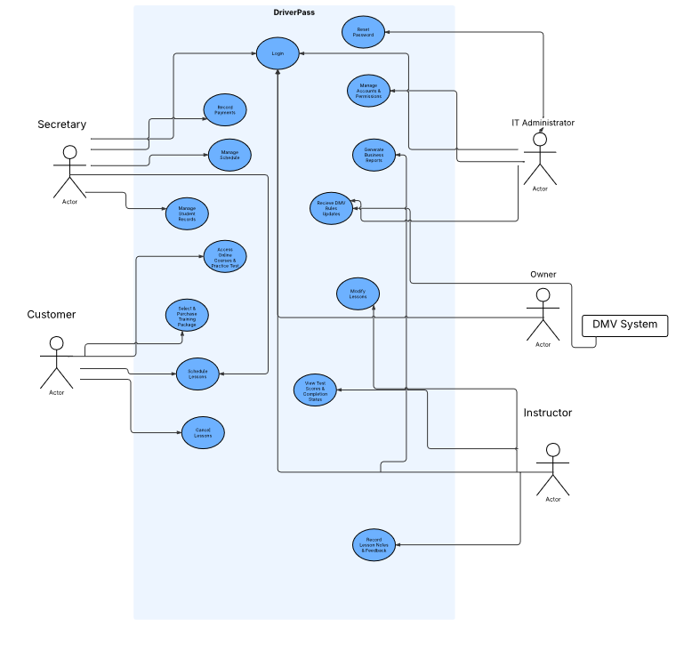
Use Case Diagram
Notes:
[Explain your diagram. Who are the different actors in the system? What are the different use cases? How did you account for DriverPass’s needs in your design? In your explanation, keep your audience in mind. Avoid the use of terms like “actors” and “use cases” in your explanation.]

Slide 4
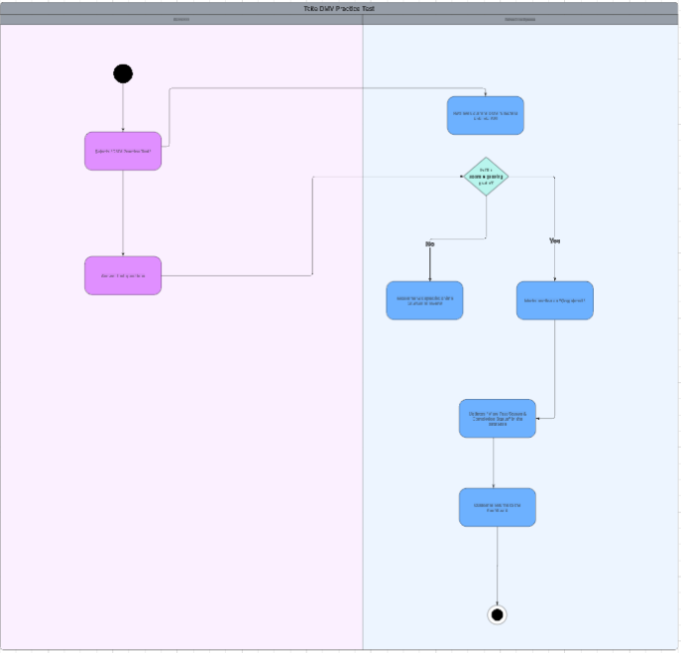
Activity Diagram
Notes:
[Explain your diagram. Which use case are you breaking down? What are the steps for this use case? How did you account for DriverPass’s needs in your design? In your explanation, keep your audience in mind. Avoid the use of technical terms such as “nodes,” “control flows,” and so on.]

Slide 5
Security
Secure login system
Encrypted data
Account lock after failed attempts
Role-based access
Notes:
[How did you consider security in your design? In your explanation, keep your audience in mind by avoiding the use of technical terms.]

Slide 6
System Limitations
Requires internet
Limited by budget/time
May not integrate fully with DMV systems
Notes:
[What are the limitations of your design? In your explanation, keep your audience in mind by avoiding the use of technical terms.]

